Slide 1
Big Teeth Reality
By SQL Pirates
Group 12 Members:
Asad Mahmood (989355987), Khushboo Patel (989354961),
Theewart Jindapoo (989354797) and Atik Ilman Hossain(989354898)

Slide 2
Slides Overview
Work Division
Entity Relation Diagram
Creating Database
Dummy Data Insertion
Project Queries
Project Explanation Document
Project Video

Slide 3
1.
Work Division
The tough part

Slide 4
Work Division
Asad Mahmood
ERD
Database Creation and Insertion of Dummy Data
Theewart Jindapoo
Database Queries
Khushboo Patel
Project Report
Atik Ilman Hossain
Project Video
Project Slides

Slide 5
2.
Entity Relationship Diagram
Let’s start with the explanation of database ERD

Slide 6
ERD - Tables
We have 17 columns in the database
All columns are in 3NF
Some column names are:
Contestant
Employer
MedicalRecord
Job
Education

Slide 7
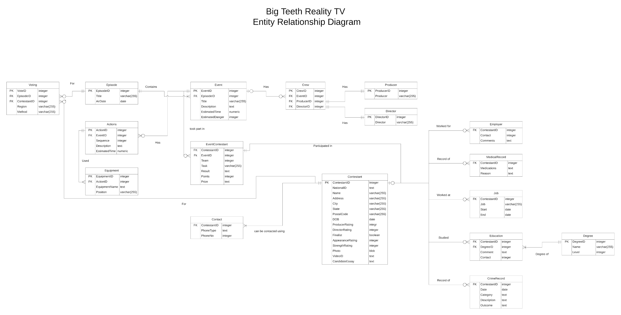

Slide 8
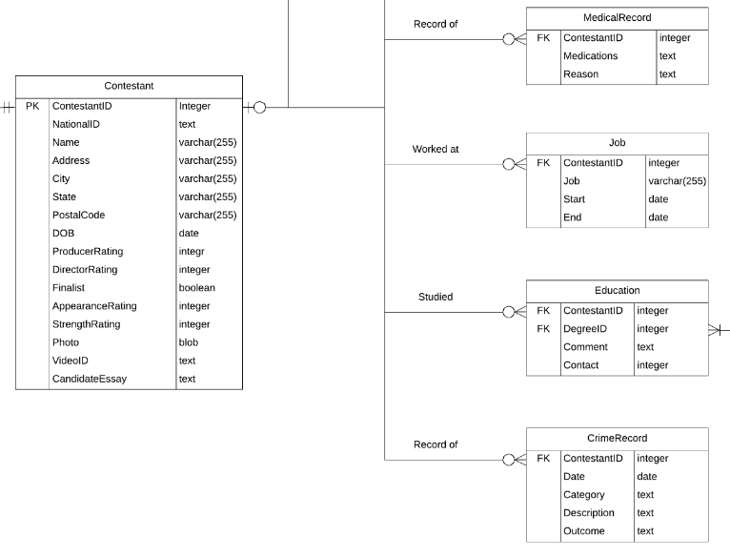
ERD - Brief Explanation
Table1 ~ Table2 | Explanation
Contestant ~ MedicalRecord | The relationship shows that zero or one contestant can have zero or many medications prescribed to him.
Contestant ~ Job | The relationship shows that zero or one contestant can have held zero or many Jobs in his life
Contestant ~ Education | The relationship shows that zero or one contestant can have availed zero or many education opportunities in his life.
Contestant ~ CrimeRecord | The relationship shows that zero or one contestant can have zero or many crime records under his/her name.

Slide 9
3.
Creating Database
Let there be a database

Slide 10
Database
SQL Database: SQLite
Tool used: DB Browser
The reason to choose SQLite is because it is a very light weighted
Reading and writing procedures are really fast
It is reliable, portable and highly accessible

Slide 11
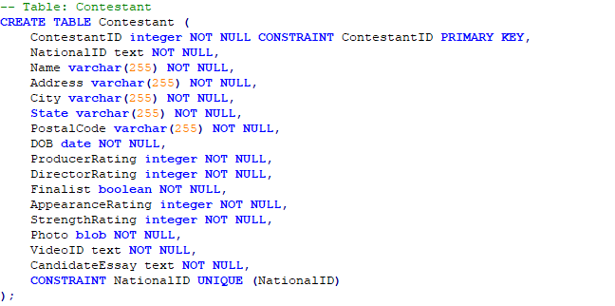
Create Table - An Example
This is contestant table create query

Slide 12
4.
Inserting Dummy Data
Project is now coming together..

Slide 13
Dummy Data
The columns with primary keys are filled first.
For Example: Contestant Table
Then columns with foreign keys are filled
For Example: MedicalRecord
The data is entered keeping into mind the queries that we are required to run.

Slide 14
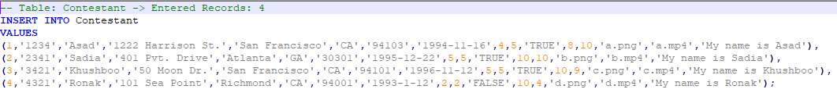
Insert Into - An Example
This is contestant table insert into query

Slide 15
5.
Project Queries
Discussion of the Queries

Slide 16
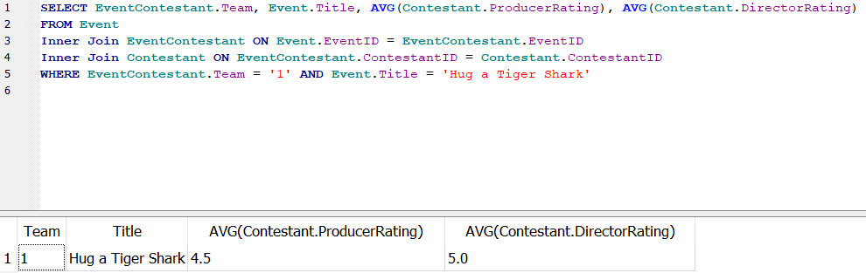
Queries
Calculate the average producer and director ratings for a Hug a Tiger Shark event's team members.

Slide 17
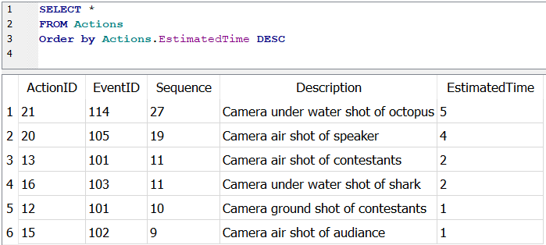
Queries
Determine which actions will take the longest. Rank all actions from longest to shortest.

Slide 18
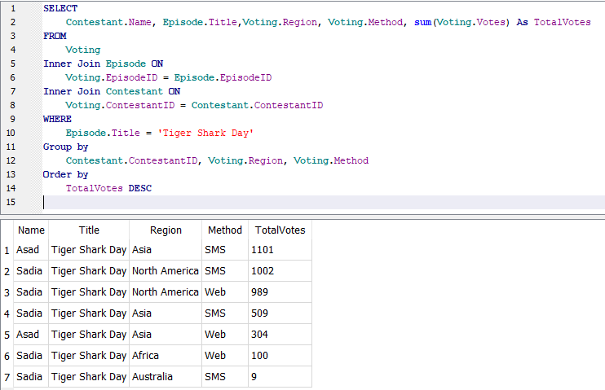
Queries
List each contestant's total votes by region and method for a Tiger Shark Day episode. Rank this from highest to lowest.

Slide 19
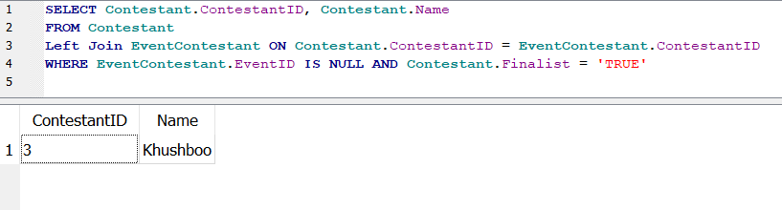
Queries
Identify which contestants have not participated in any events.

Slide 20
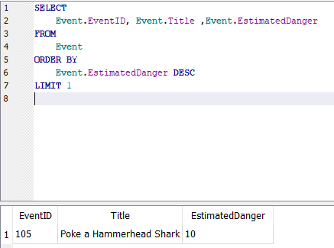
Queries
What is the highest estimated danger level for any event?

Slide 21
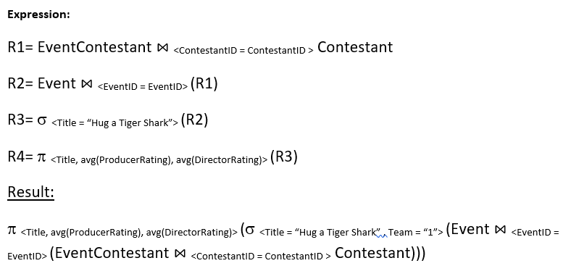
Queries
Query1 Relational Expression

Slide 22
6.
Project Report
Detailed information about the project

Slide 23
Report
It contains details about ERD
ERD created for the project is published in it.
Relationship between different entities are explained in detail.
It contains details regarding creation of the database
It shows a few of create queries and discusses their data types, etc.

Slide 24
Report
It contains details about data insertion queries
Lastly it contains explanation about project queries

Slide 25
7.
Project Video
and Presentation

Slide 26
Video & Presentation
Created a summarized version of everyone’s work so that it could be included in slides
Helped in various other tasks like getting project material in order for submission
Combined videos of every participant into one fluid video.

Slide 27
THANKS!
Any questions?
You can find us at:
Asad Mahmood: a_mahmood@u.pacific.edu
Theewart Jindapoo: t_jindapoo@u.pacific.edu
Khushboo Patel: k_patel47@u.pacific.edu
Atik Ilman Hossain: a_hossain1@u.pacific.edu

Slide 28
References
https://www.javatpoint.com/sqlite-advantages-and-disadvantages
https://www.guru99.com/database-normalization.html

